Slide 1

CAR DEKHO SMART RESALE DECISION SYSTEM Data-Driven Insights for Better Used-Car Decisions
ACITE STUDENT ID : STU6a6b5fa76dafc1785421735
NAME : NISHA R
COLLEGE : RAMCO INSTITUTE OF TECHNOLOGY

Slide 2

PROBLEM STATEMENT
Choosing a used car is not simply about finding the lowest price.
A vehicle's resale value is influenced by multiple factors such as its age, current market price, kilometers driven, fuel type, transmission and ownership history.
However, raw vehicle data does not clearly indicate how these factors are associated with selling price.

Slide 3
PROJECT DESCRIPTION From Raw Records → Smart Decisions USED-CAR DATASET ↓ DATA CLEANING ↓ EXPLORATORY DATA ANALYSIS ↓ FACTOR COMPARISON ↓ PRICE PATTERN DISCOVERY ↓ RESALE INSIGHTS

Slide 4

WHO ARE THE END USERS?
Make this visually like a 4-user ecosystem.
🚘BUYERS
🏪DEALERS
💼SELLERS
📊DATA ANALYSTS

Slide 5

TECHNOLOGY USED
Python
Pandas
NumPy
Matplotlib
Seaborn
Google Colab

Slide 6
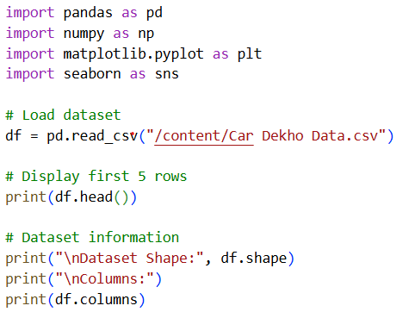
RESULTS
1. Import and Load the dataset

Slide 7
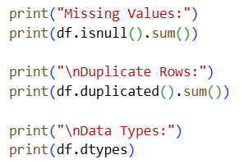
2. Data Quality Check
3. Remove Duplicate Records

Slide 8
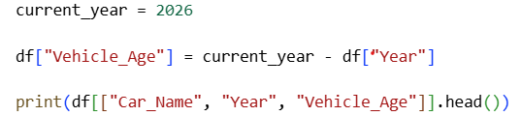
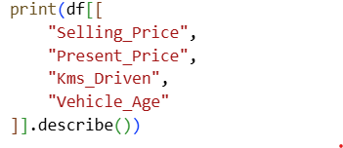
4. Create Vehicle Age
5. Basic Statistics

Slide 9
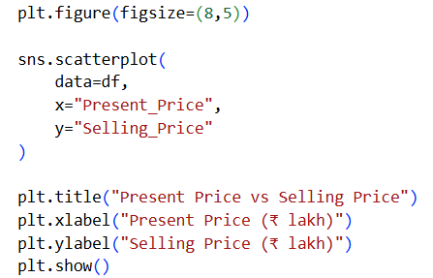
6. Present Price vs Selling Price

Slide 10
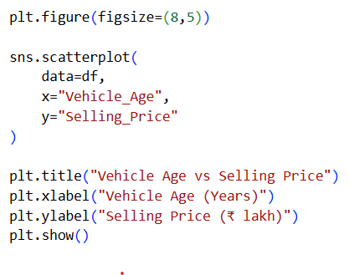
7. Vehicle Age vs Selling Price

Slide 11
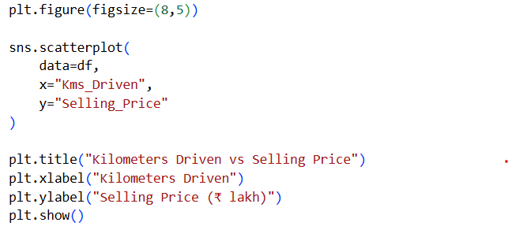
8. Kilometers Driven vs Selling Price

Slide 12
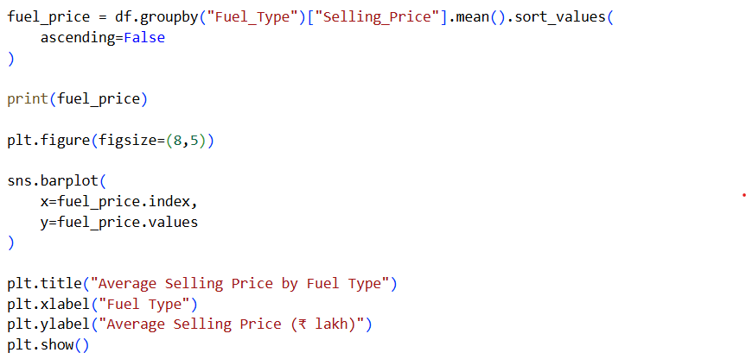
9. Fuel Type Analysis

Slide 13
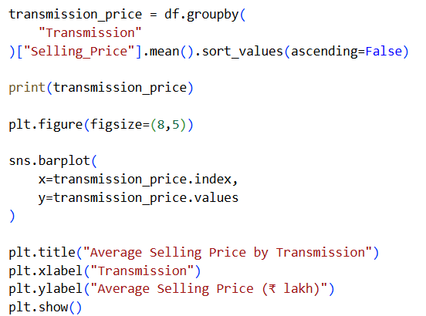
10. Transmission Analysis

Slide 14
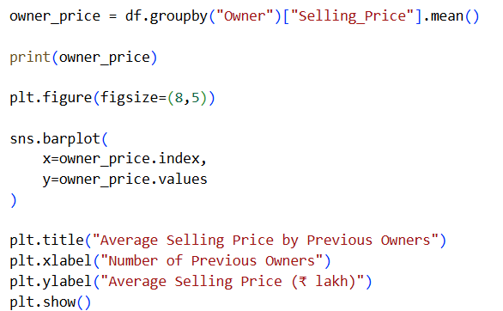
11. Owner Analysis

Slide 15
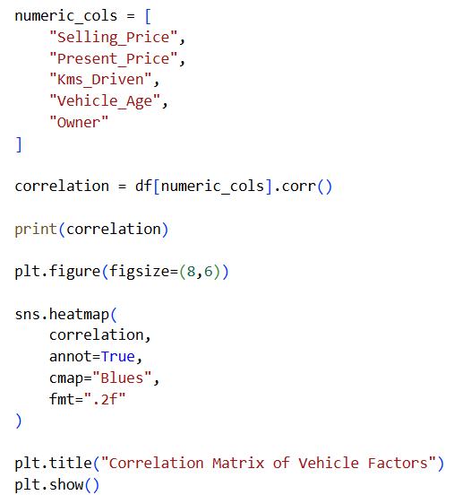
12. Correlation Analysis

Slide 16
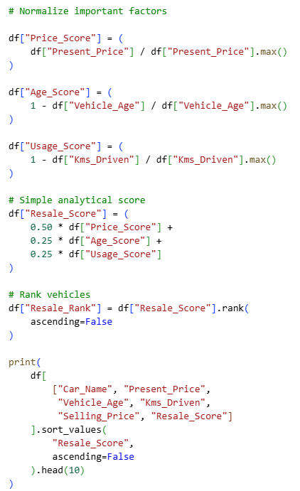
Final "Smart Decision" Section

Slide 17
THANK YOU
“Better data. Better insights. Smarter resale decisions.”
.
.
DEMO LINK: https://github.com/its-nishar/Smart-Resale-Decision-System-in-Car

